Slide 1
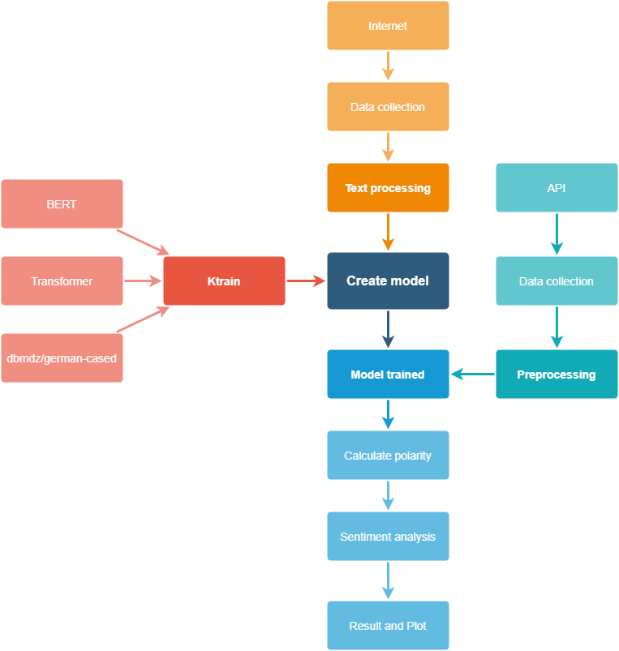
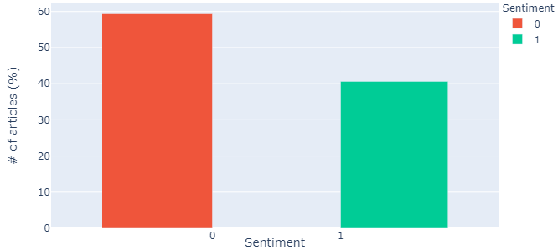
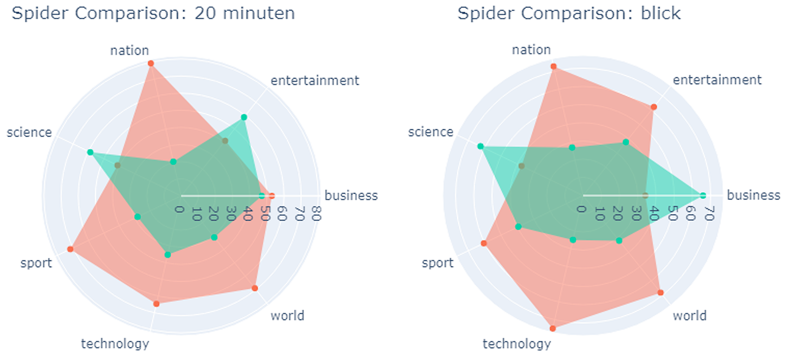
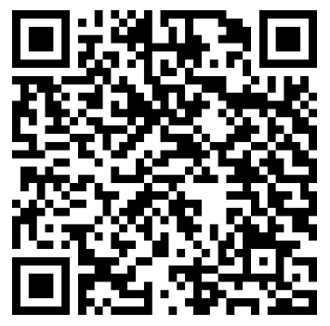
Introduction
Today’s newspapers have the power to shape one’s entire perspective on the world. The idea is to create, train, adjust and improve a model so that it is fit to analyze various Swiss newspapers and to determine which papers are written with the most negative and positive attitude.
Project pipeline
Methods
Model setup
BERT, HuggingFace, Ktrain
Filmstarts database
Newspaper database setup
Data collection from APIs
Preprocessing APIs data
Automation
Sentiment Analysis
Feature engineering
Polarity calculation
Plotting
Analyze results
Model
In the process of the work, I created several models, each model being an improvement of the previous one. The first two models are based on the English language, then I trained the later models for the German language.
Model | Dataset | Accuracy
Ktrain1 | Hotel Reviews (EN) | 85%
Ktrain1 2ver | Hotel Reviews (EN) | 96%
Ktrain2 auto | Filmstarts (DE) | 90%
Ktrain3 manual | Filmstarts (DE) | 93%
Sentiment Analysis
From the graphs I could see that most of the articles (in German) that we read in Switzerland have negative sentiments. Percentage is 60% NEG/40% POS(Fig2). In Fig3 is a comparison between 2 newspaper.
References
Fig 1: project pipeline
Fig 2: % sentiment
Fig 3: spider sentiment on «20 minuten» and «blick»
Conclusion
This work could very well be part of studying a psychological thesis on the masses, to see how the polarity of the news can influence our life.
Sentiment Analysis on Swiss Newspapers
Graduate: | Giorgio Bakhiet Derias
Professor: | Mascha Kurpicz-Briki
Expert: | Andreas Dürsteler
Bachelor Thesis 2021 Degree Programme Computer Science

